Slide 1
LPG BOOKING SYSTEM
Manjot Singh
12016413
Aditya Kumar Singh
12018694
PYTHON PROGRAMMING (INT 213)

Slide 2
Introduction
‘LPG Booking System’ is a GUI based System for the agency to minimize their work and let the System handle the records. It also makes it easier for the agency to check the number as a person has booked in a specific amount of time and the person who is booking the gas is authenticated or not whether he/she has bought the refill within the time period, to get his gas booked.

Slide 3
Team Members
Aditya Kumar Singh
Contributions:-
1. Coding (joined)
2. GUI
3. Linking with My SQLDatabase
Manjot Singh
Contributions:-
1. Coding (joined)
2. GUI
3. Report & PPT

Slide 4
Libraries
Tkinter :-
Tkinter is the standard GUI library for Python. Python when combined with Tkinter provides a fast and easy way to create GUI applications. Tkinter provides a powerful object-oriented interface to the Tk GUI toolkit.
Messagebox from tkinter:-
TkinterMessagebox is a module in python which provides a different set of dialogues that are used to display message boxes, showing errors or warnings, widgets to select files or change colors which is a pop-up box with a relevant message being displayed. Here, it’s used to display several messages when a customer is successfully added or deleted or when a booking is done successfully and many more.

Slide 5
Mysql.connector :-
MySQL.Connector enables Python programs to access MySQL databases, using an API that is compliant with the Python Database API Specification. It is written in pure Python and does not have any dependencies except for the Python Standard Library.
Image,ImageTk from PIL :-
The imageTk module contains support to create and modify TkinterBitmapImage and PhotoImage objects from PIL images.
Ttk from tkinter:-
The tkinter. ttk module provides access to the Tk themed widget set, introduced in Tk 8.5. The basic idea for tkinter. ttk is to separate, to the extent possible, the code implementing a widget's behaviour from the code implementing its appearance.

Slide 6
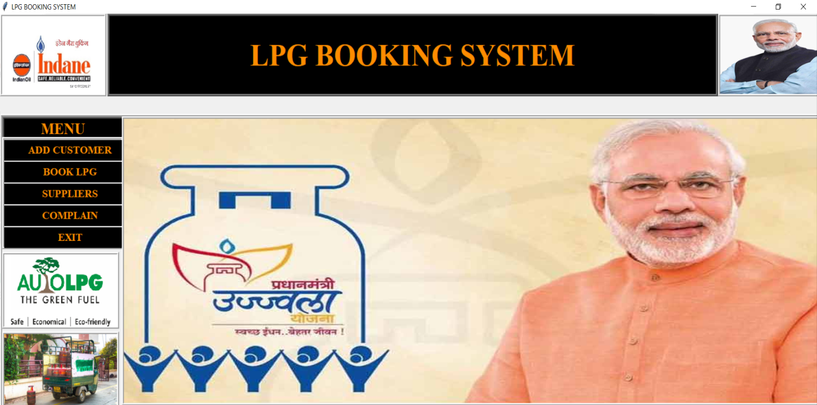
Main Page

Slide 7
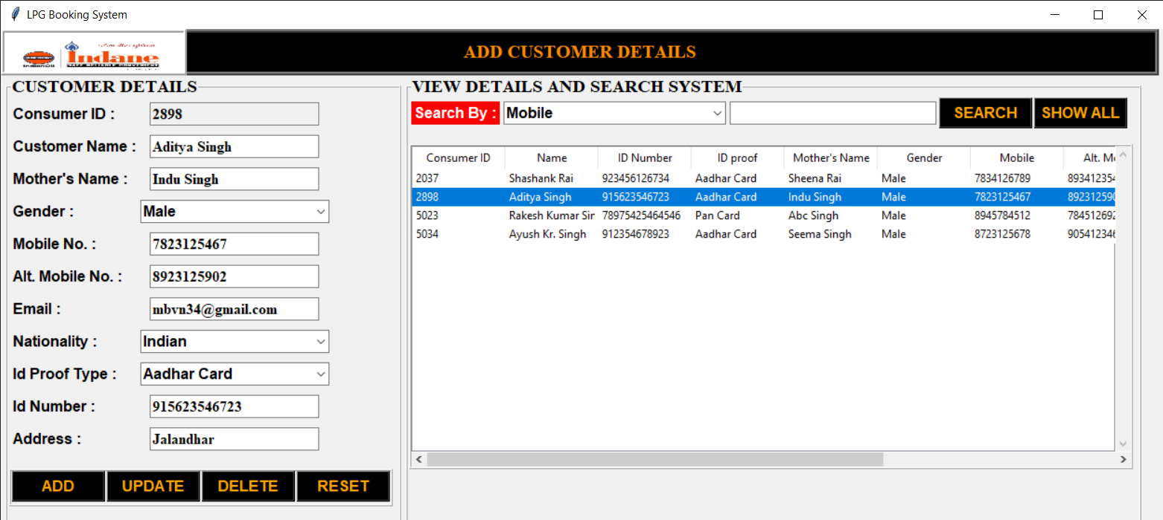
Add Customer Page

Slide 8
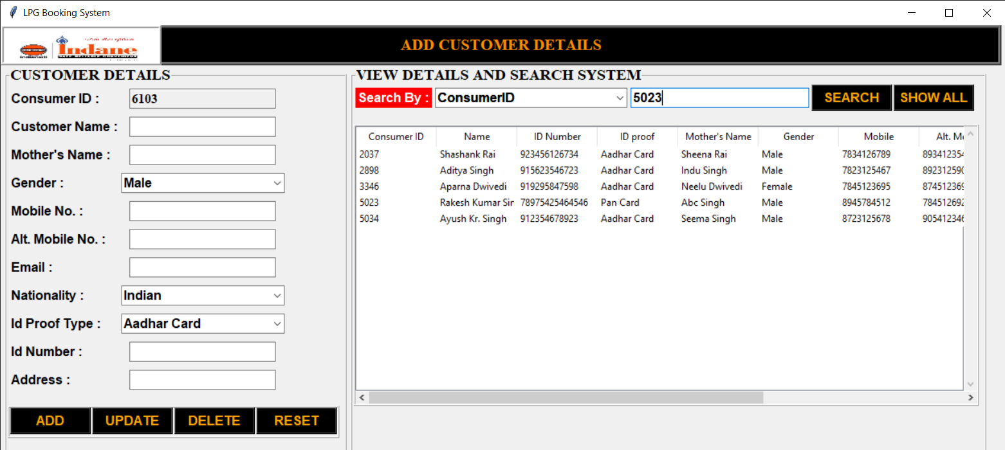
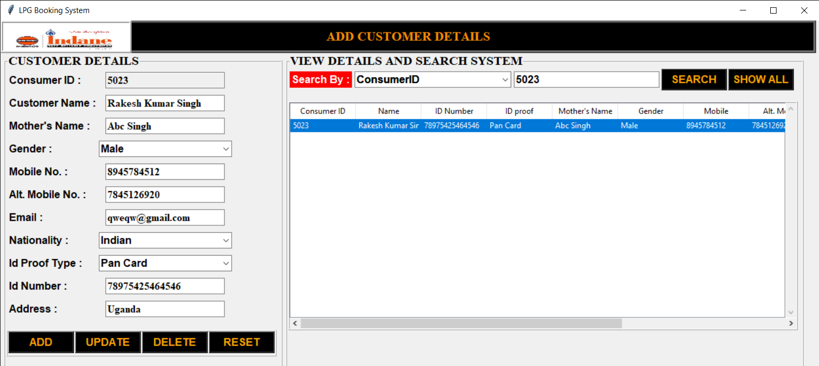
Search Customer

Slide 9
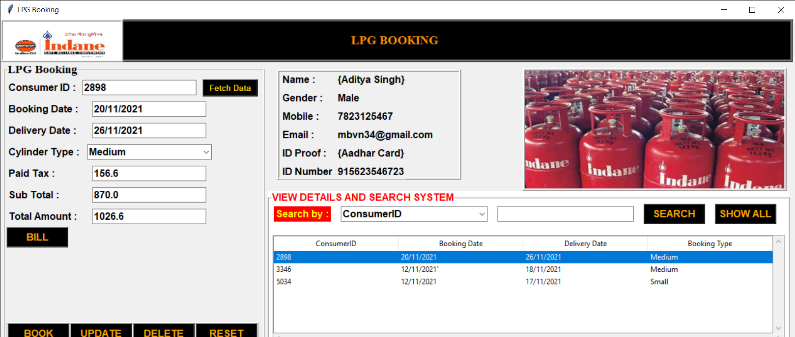
Booking Page

Slide 10
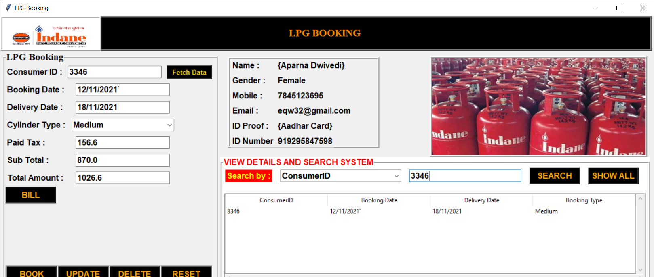
Booking Search using Consumer ID

Slide 11
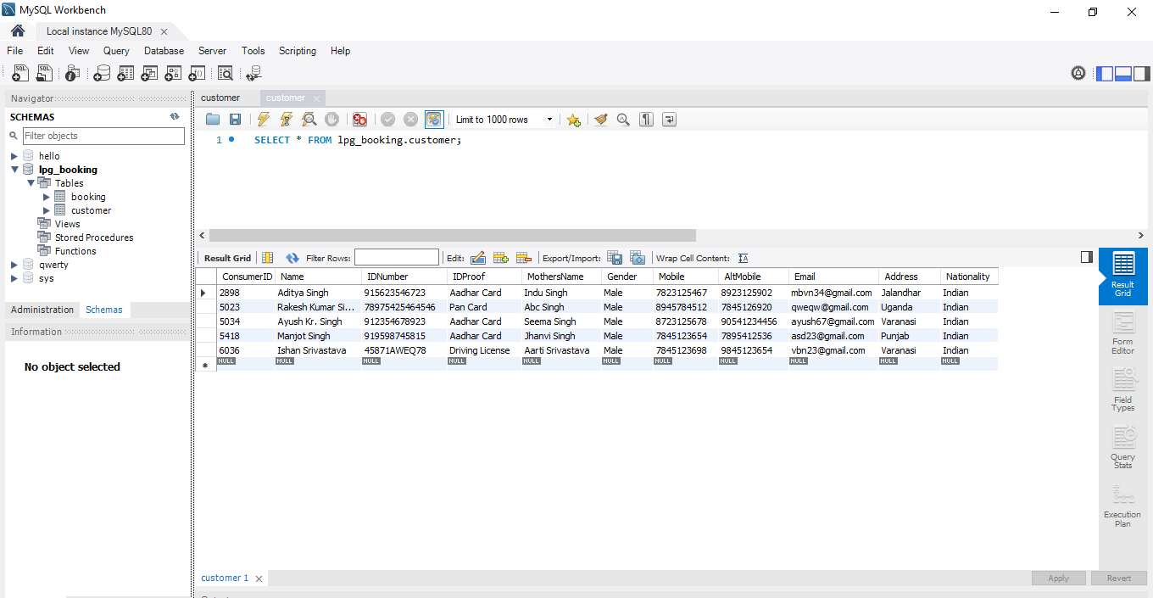
Database Customer Records

Slide 12
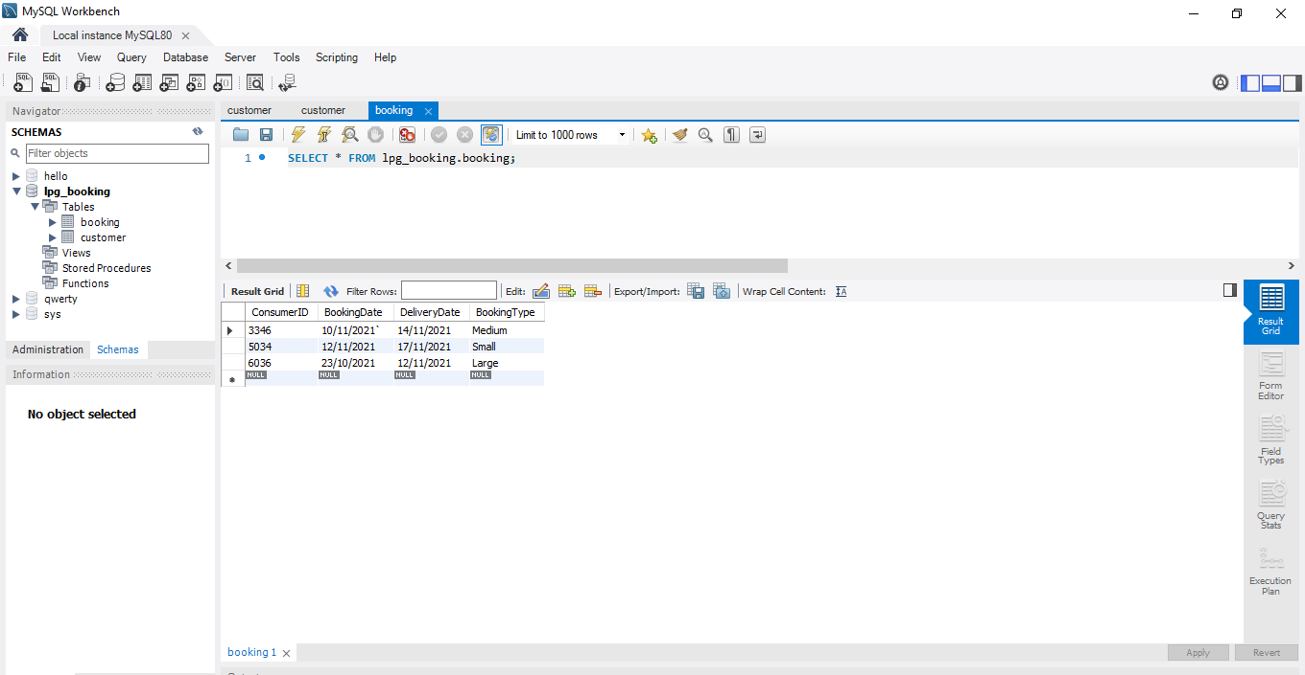
Database Customer Records

Slide 13
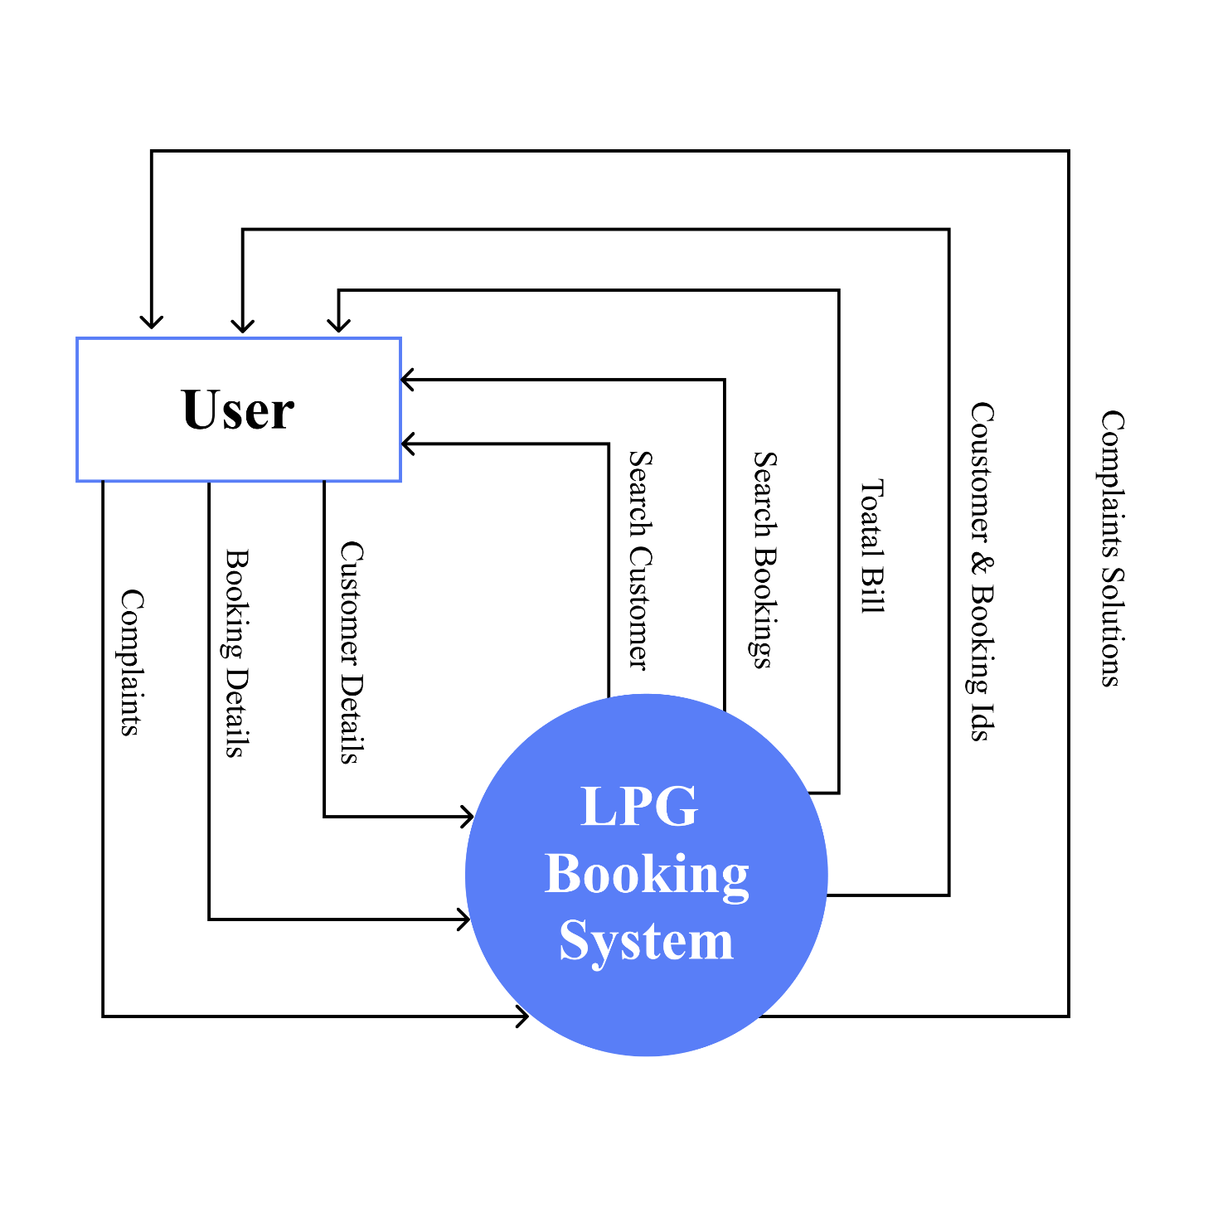
Data Flow Diagram

Slide 14
Conclusion
The LPG gas booking system is sumarized in this report .This project gives a completely programmed approch towards the gas booking and record mantainance on the database. This project saves the time of agency and also gives a security of data. Data can be searched ,deleted and updated only in one click in the database .
I hope this project proves to be a great help to agency

Slide 15
Thank you

